Slide 1
Quelques Lémuriens de Madagascar

Slide 2
Propithecus verreauxi

Slide 3
Propithecus deckenii

Slide 4
Propithecus coquereli

Slide 5
Propithecus diadema

Slide 6
Propithecus tattersalli

Slide 7
Propithecus candidus

Slide 8
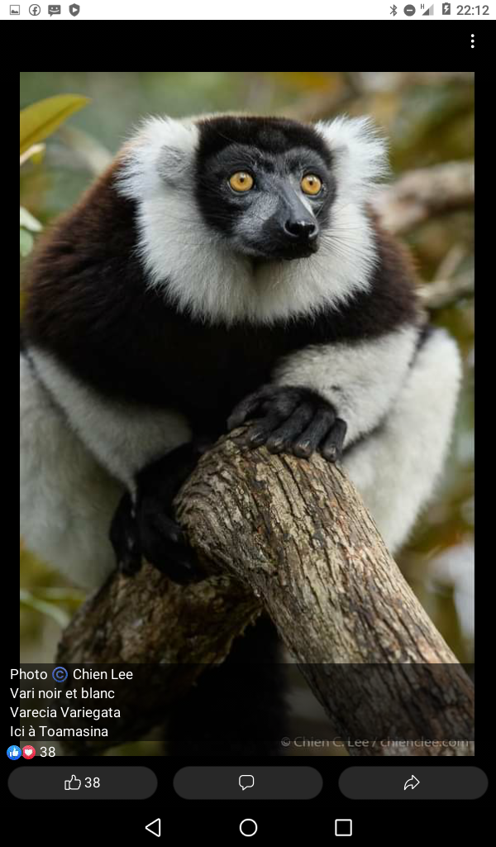
Varicea variegata

Slide 9
Varicea rubra

Slide 10
Varicea rubra

Slide 11
Microcebus rufus

Slide 12
Microcebus murinus

Slide 13
Microcebus ravelobensis

Slide 14
Daubentonia madagascariensis

Slide 15
Lepilemur mustelinus

Slide 16
Lepilemur randrianasoli

Slide 17
Eulemur sanfordi

Slide 18
Eulemur albifrons

Slide 19
Eulemur mongoz

Slide 20
Indri indri

Slide 21
Hapalemur alaotrensis (Bandro)

Slide 22
Hapalemur alaotrensis

Slide 23
Lepilemur

Slide 24
Lepilemur edwards

Slide 25
Lepilemur microdon

Slide 26
Lemur coronatus

Slide 27
Lemur fulvus

Slide 28
Lemur fulvus

Slide 29
Lemur catta

Slide 30
Lemur macaco

