Slide 1
Quelques Lémuriens de Madagascar

Slide 2
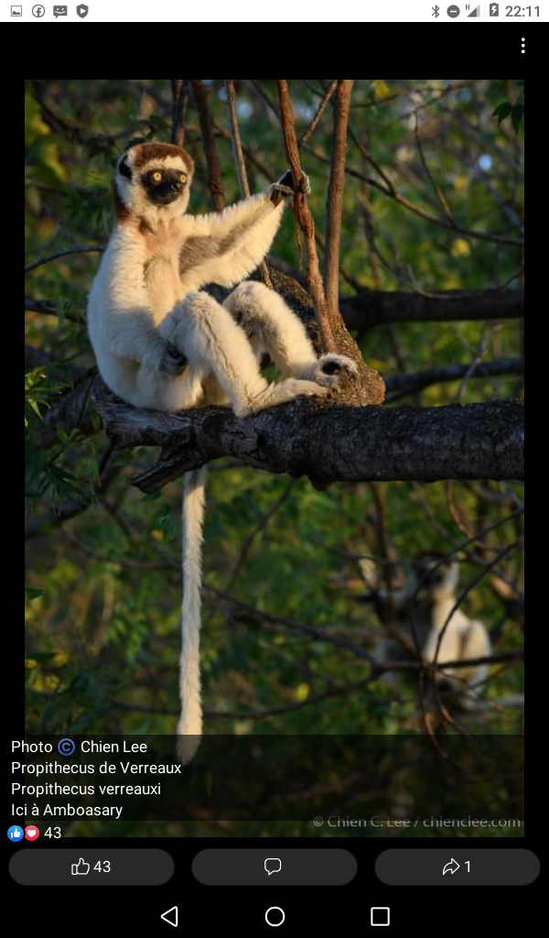
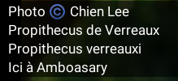
Propithecus verreauxi

Slide 3
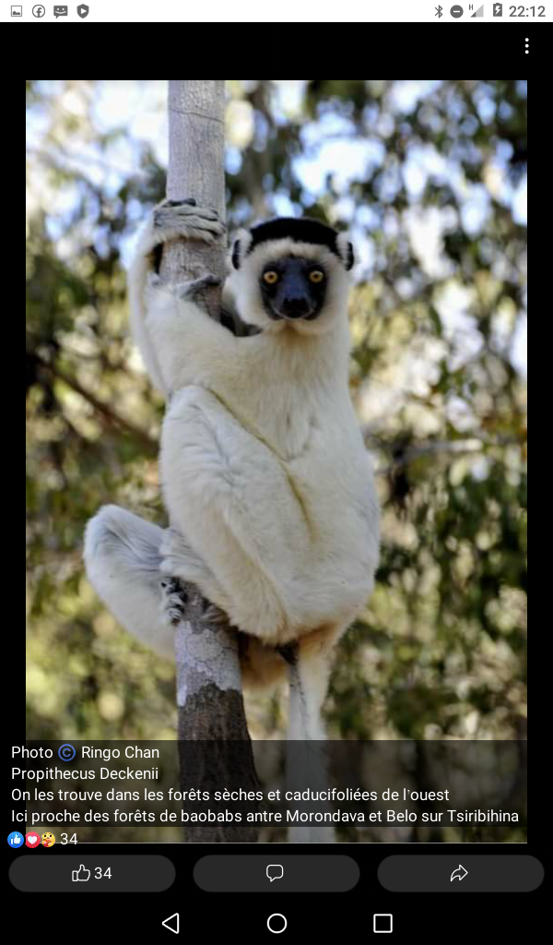
Propithecus deckenii

Slide 4
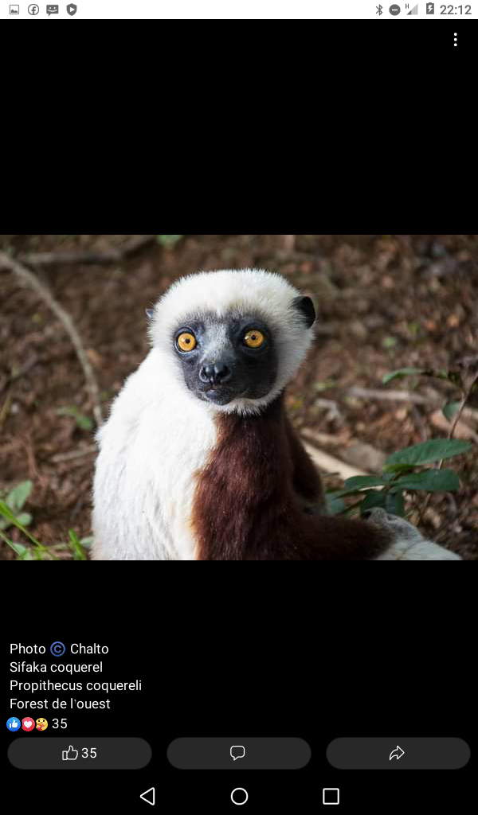
Propithecus coquereli

Slide 5
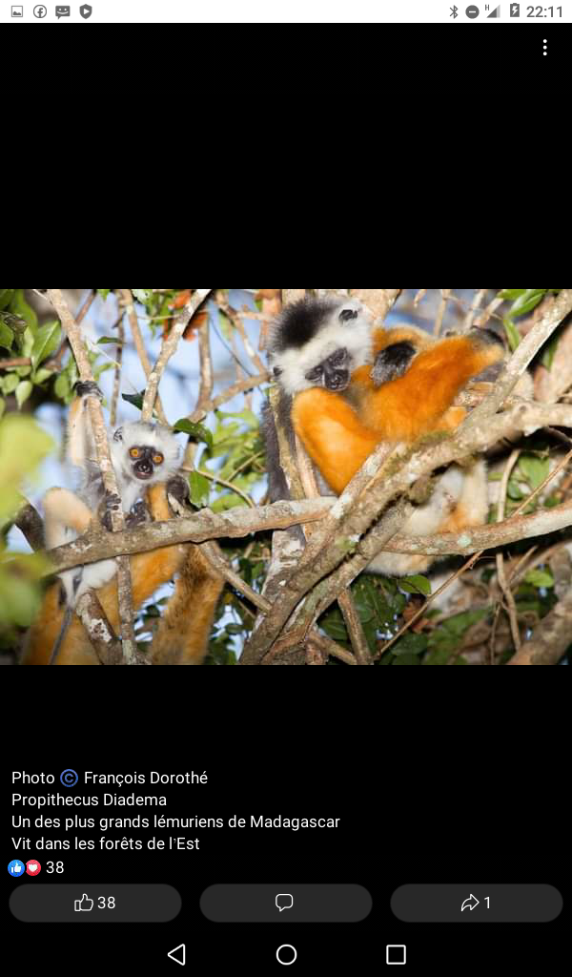
Propithecus diadema

Slide 6
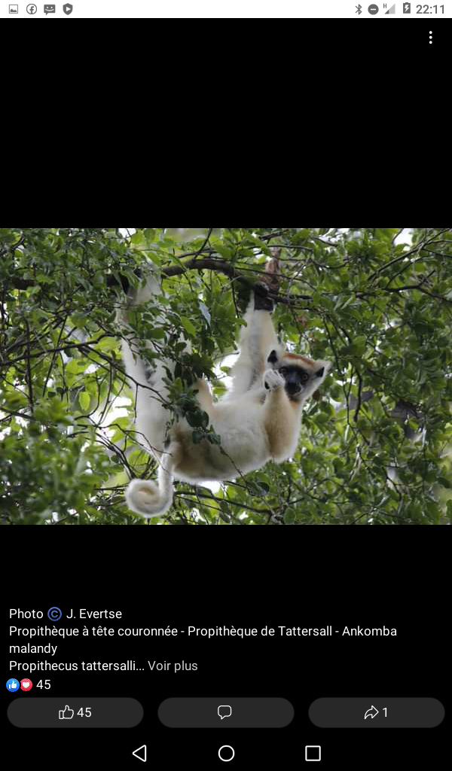
Propithecus tattersalli

Slide 7
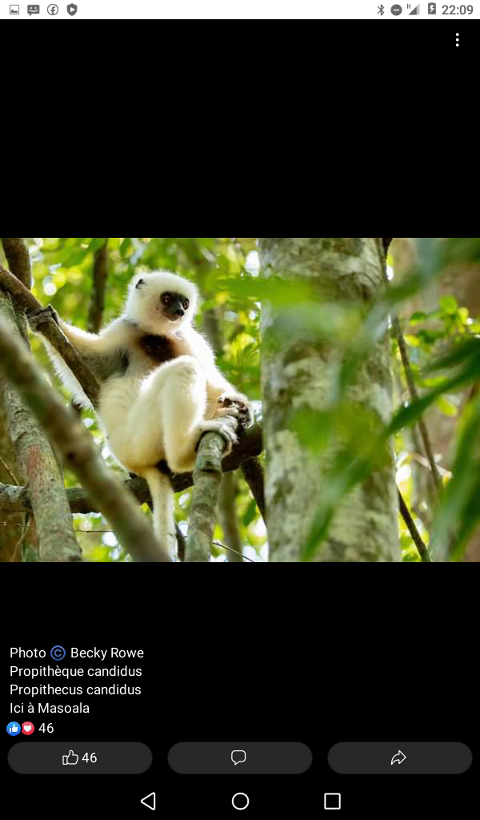
Propithecus candidus

Slide 8
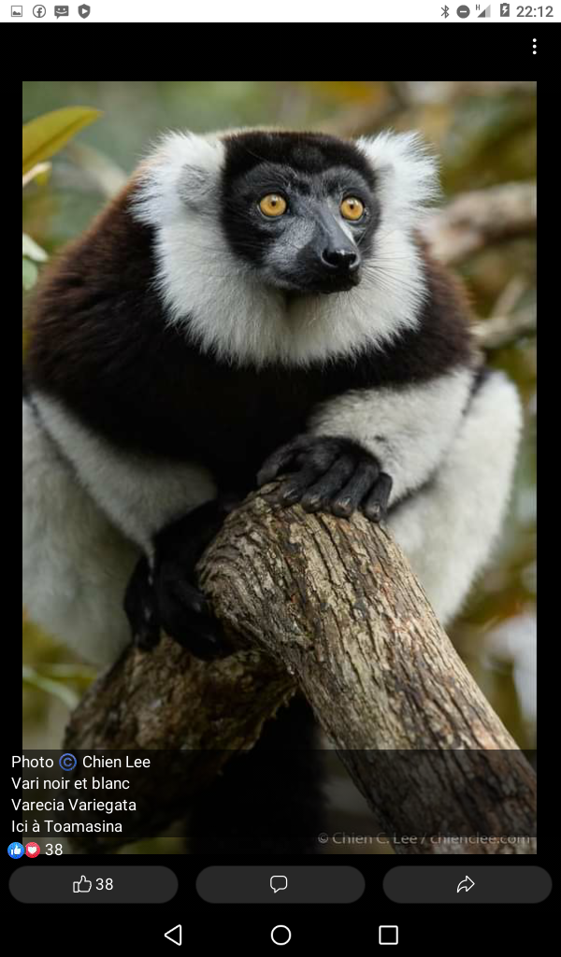
Varicea variegata

Slide 9
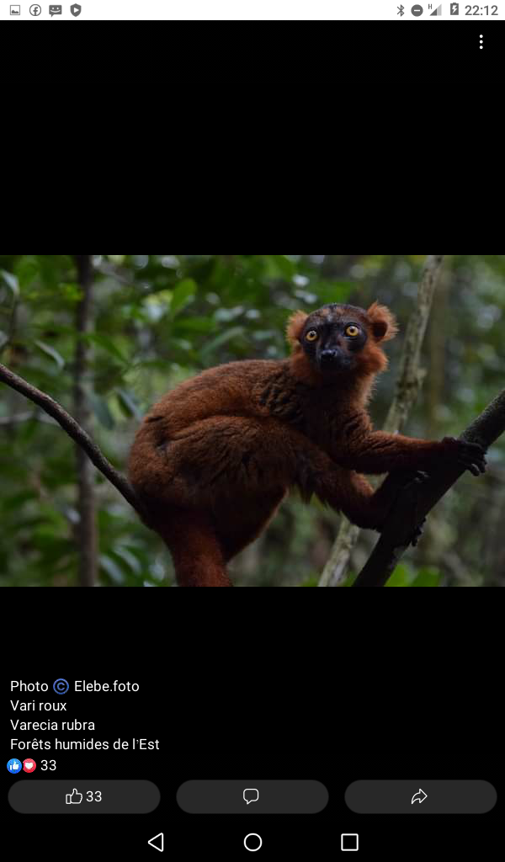
Varicea rubra

Slide 10
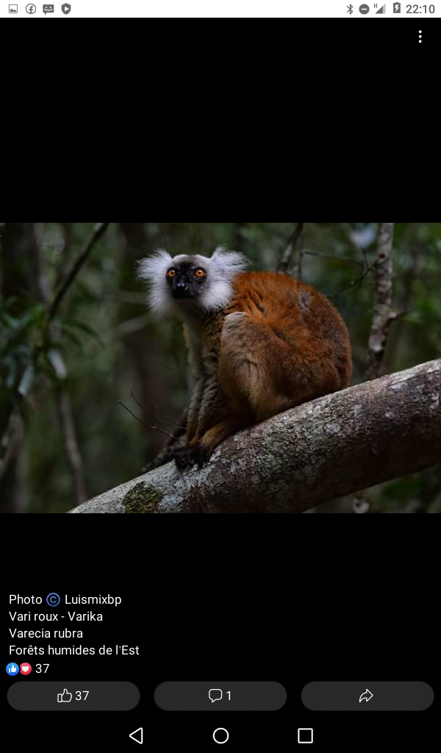
Varicea rubra

Slide 11
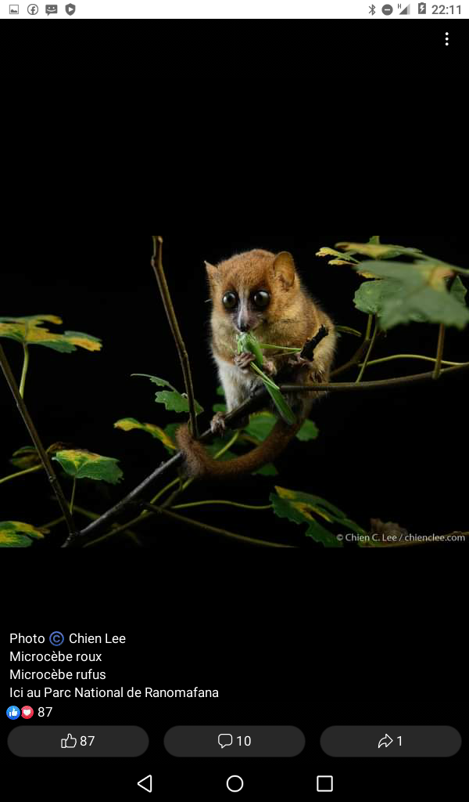
Microcebus rufus

Slide 12
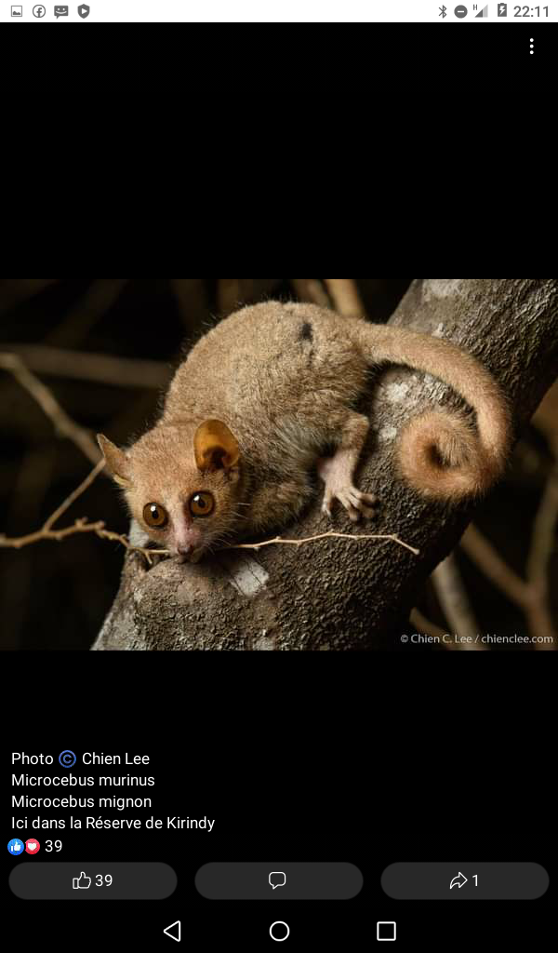
Microcebus murinus

Slide 13
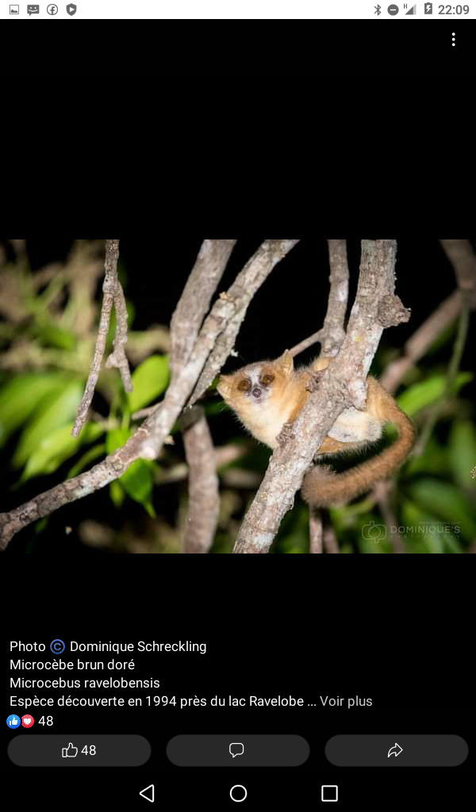
Microcebus ravelobensis

Slide 14
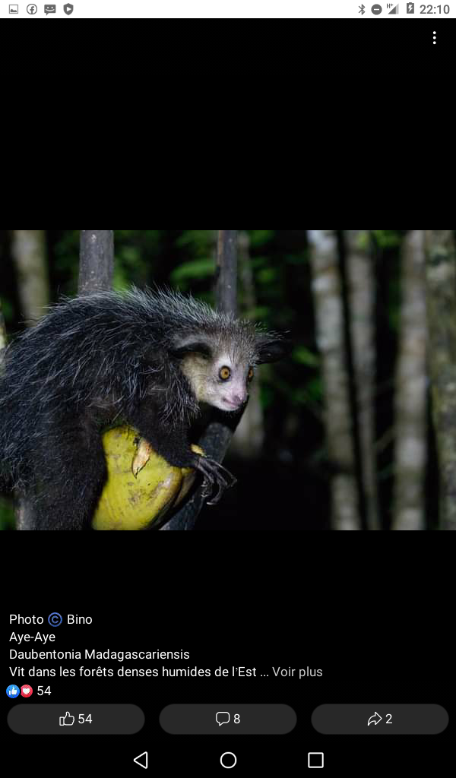
Daubentonia madagascariensis

Slide 15
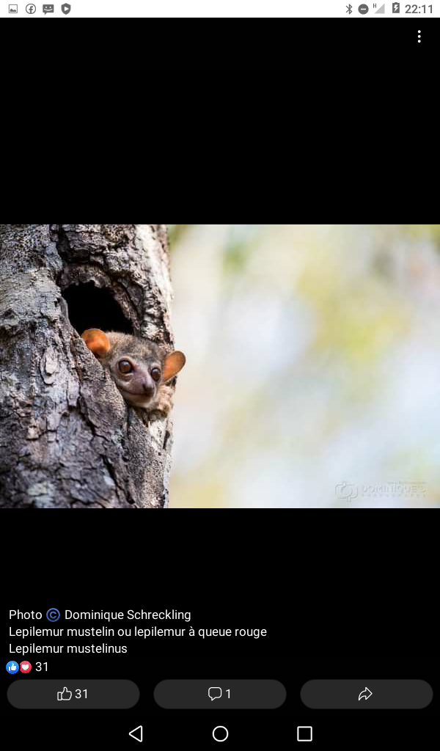
Lepilemur mustelinus

Slide 16
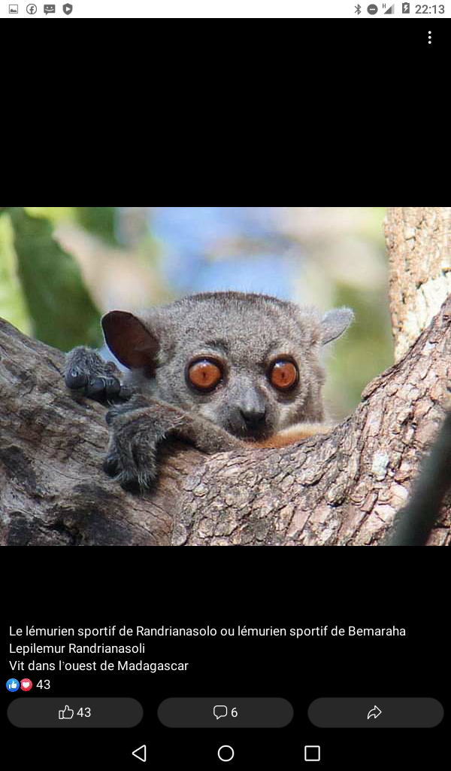
Lepilemur randrianasoli

Slide 17
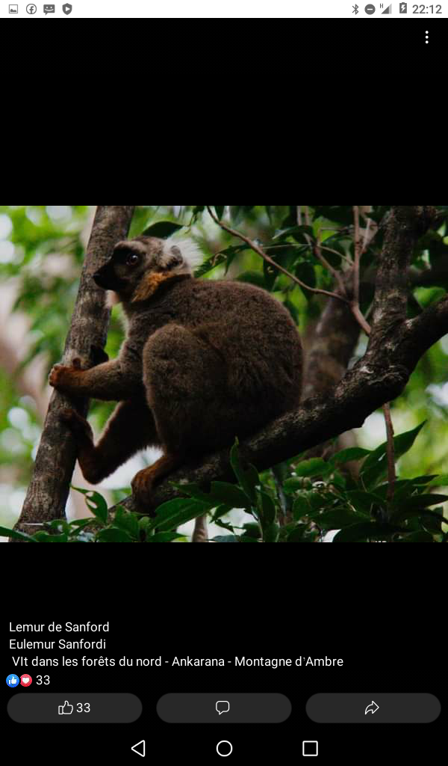
Eulemur sanfordi

Slide 18
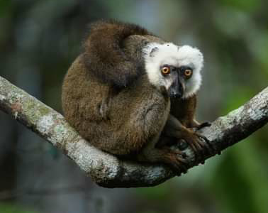
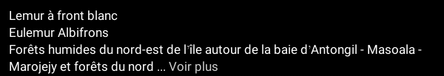
Eulemur albifrons

Slide 19
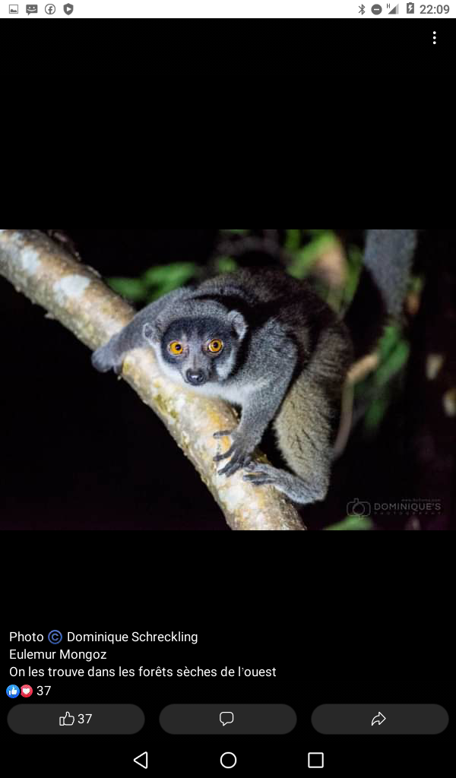
Eulemur mongoz

Slide 20
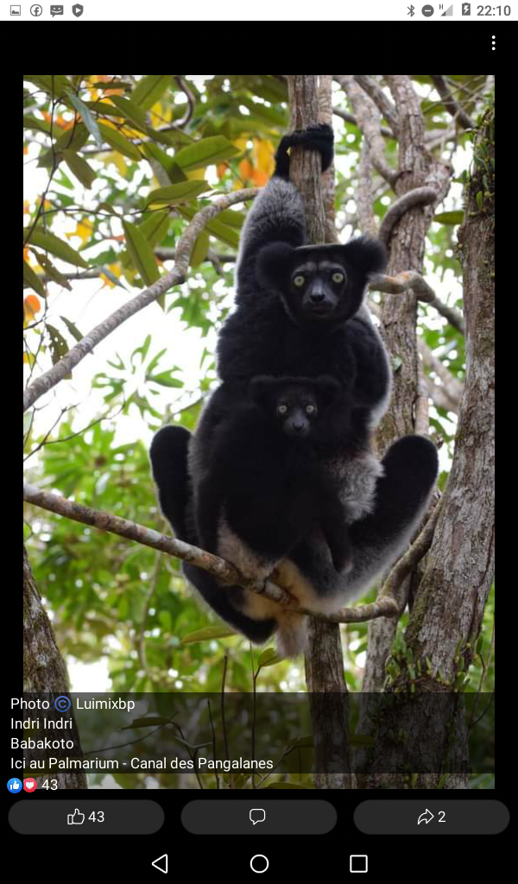
Indri indri

Slide 21
Hapalemur alaotrensis (Bandro)

Slide 22
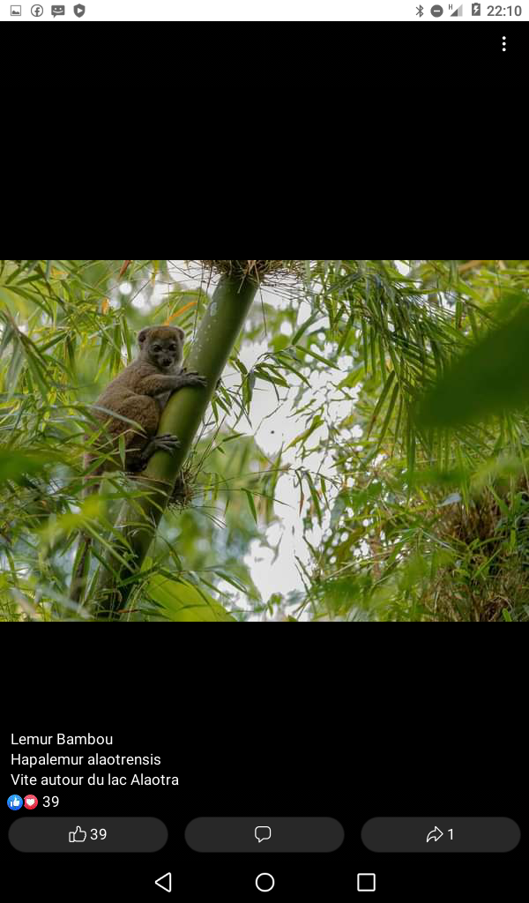
Hapalemur alaotrensis

Slide 23
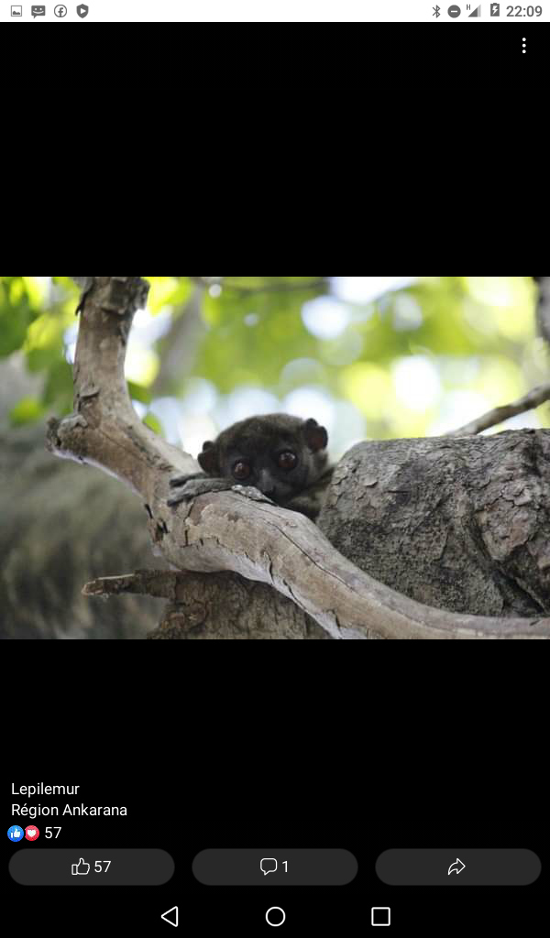
Lepilemur

Slide 24
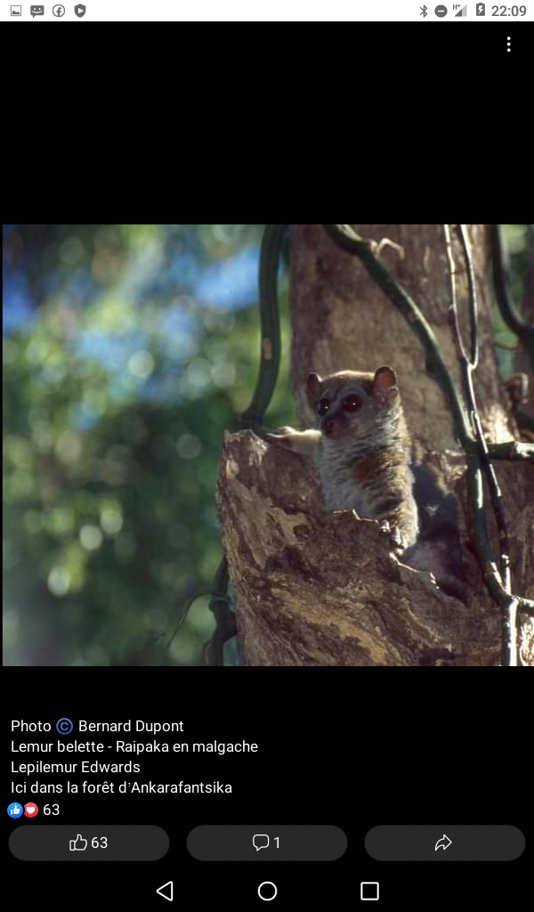
Lepilemur edwards

Slide 25
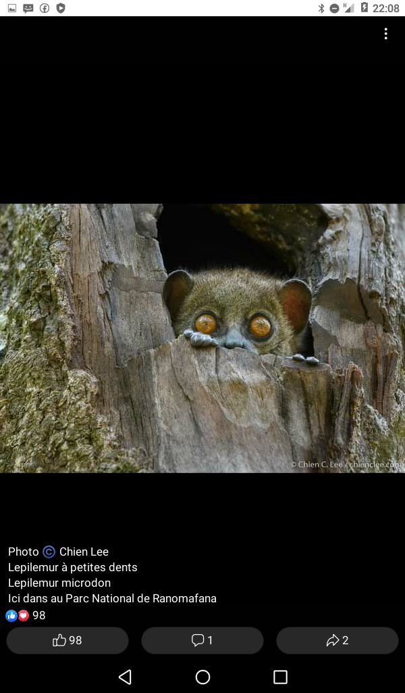
Lepilemur microdon

Slide 26
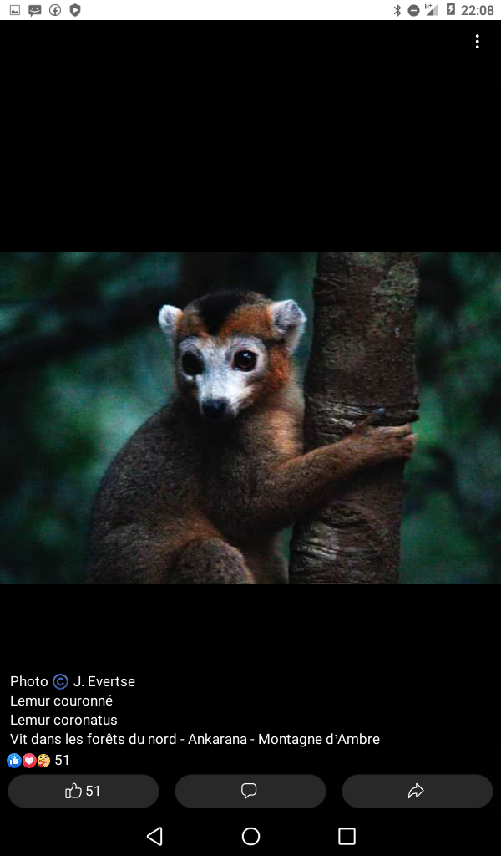
Lemur coronatus

Slide 27
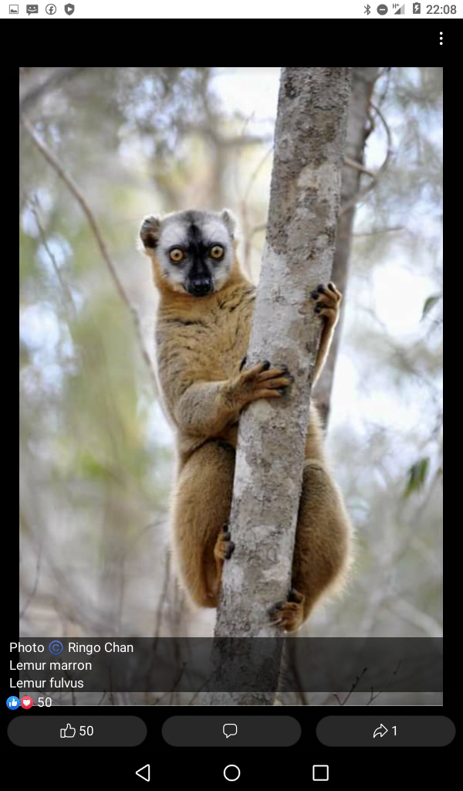
Lemur fulvus

Slide 28
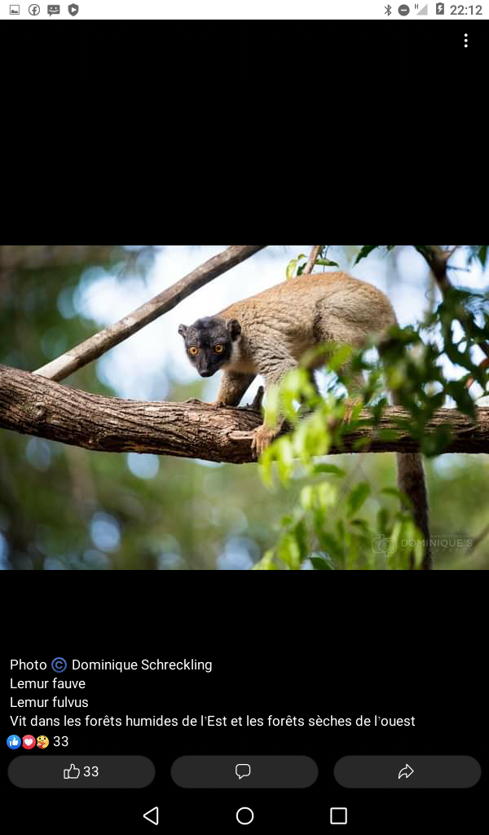
Lemur fulvus

Slide 29
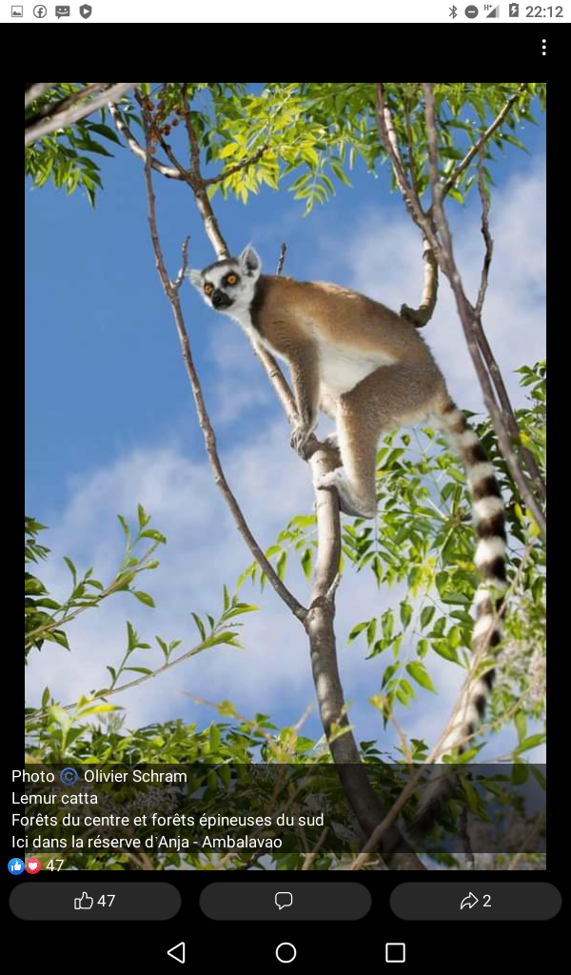
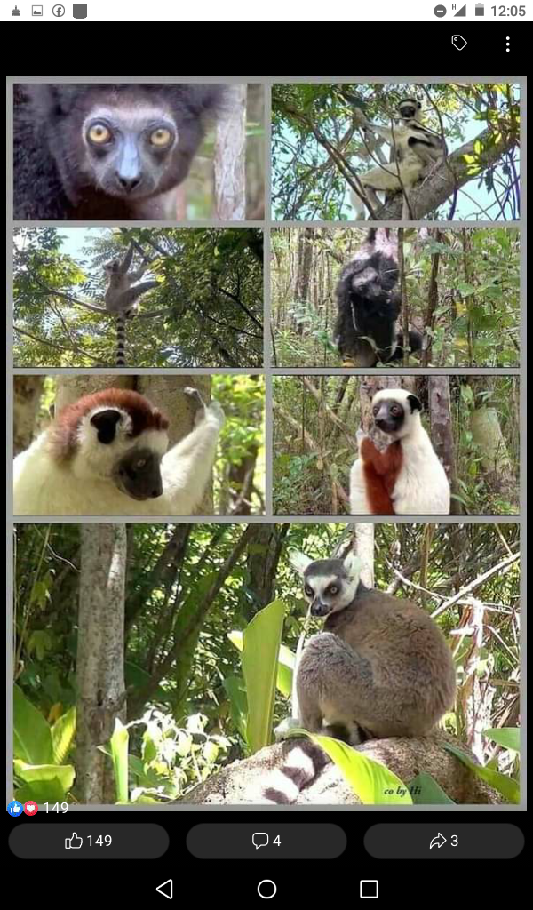
Lemur catta

Slide 30
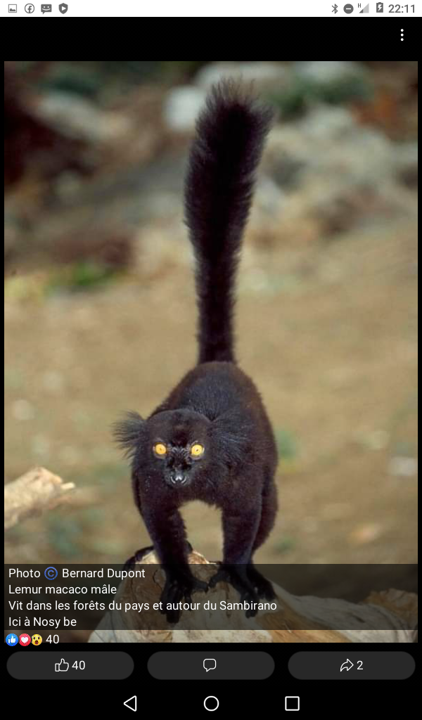
Lemur macaco

